Slide 1

Malignant comments classifier
By Ashok Kumar Sharma

Slide 2
ACKNOWLEDGMENT
I would like to express my deep sense of gratitude to my SME (Subject Matter Expert) Mr. Shubham Yadav as well as Flip Robo Technologies who gave me the golden opportunity to project on Malignant Comments Classifier, which also helped me in doing lots of research and I came to know about so many new things.
I am very much thankful to Mr. Shankargouda Tegginmani, Trainer (DataTrained), for their valuable guidance, keen interest and encouragement at various stages of my training period which eventually helped me a lot in doing this project.
I also acknowledge with thanks for suggestion and timely guidance, which I have received from my SME Mr. Shubham Yadav during this project, which immensely helped me in the evaluation of my ideas on the project.
Ashok Kumar Sharma

Slide 3
introduction
Business Problem Framing
The proliferation of social media enables people to express their opinions widely online. However, at the same time, this has resulted in the emergence of conflict and hate, making online environments uninviting for users. Although researchers have found that hate is a problem across multiple platforms, there is a lack of models for online hate detection. Online hate, described as abusive language, aggression, cyberbullying, hatefulness and many others has been identified as a major threat on online social media platforms. Social media platforms are the most prominent grounds for such toxic behaviour.
There has been a remarkable increase in the cases of cyberbullying and trolls on various social media platforms. Many celebrities and influences are facing backlashes from people and have to come across hateful and offensive comments. This can take a toll on anyone and affect them mentally leading to depression, mental illness, self-hatred and suicidal thoughts.

Slide 4
introduction
Conceptual Background of the Domain Problem
Internet comments are bastions of hatred and vitriol. While online anonymity has provided a new outlet for aggression and hate speech, machine learning can be used to fight it. The problem we sought to solve was the tagging of internet comments that are aggressive towards other users. This means that insults to third parties such as celebrities will be tagged as unoffensive, but “u are an idiot” is clearly offensive. Our goal is to build a prototype of online hate and abuse comment classifier which can used to classify hate and offensive comments so that it can be controlled and restricted from spreading hatred and cyberbullying.

Slide 5
introduction
Review of Literature
What is Comment?
A comment is a remark or observation that expresses a person's observation or criticism.

Slide 6
introduction
Motivation for the Problem Undertaken
This model can be used by the social media websites where user expresses their opinion by commenting text. This model can classify hate and offensive comments so that it can be controlled and restricted from spreading hatred and cyberbullying.

Slide 7
Analytical Problem Framing
Mathematical/ Analytical Modeling of the Problem
For checking datatypes and null values, pandas.DataFrame.info() and pandas.Series.isnull().sum() method has been used. To drop the null values pandas.DataFrame.dropna() method has been used. To replace and remove the certain terms and punctuations, pandas.Series.str.replace() method with regular expression has been used. To get rid of stop words, nltk.corpus.stopwords() method has been used. For stemming words, nltk.stem.SnowballStemmer() has been used.

Slide 8
Analytical Problem Framing
Data Inputs- Logic- Output Relationships
Input | Logic (algorithm) | Output
comment_text (object) | GaussianNB MultinomialNB | [malignant, highly_malignant, rude, threat, abuse, loathe]
There is 1 input variable needs to be provided to the logic to get the output i.e. [malignant, highly_malignant, rude, threat, abuse, loathe]. Logic highlighted in bold i.e. MultinomialNB is the best performing algorithm among all other logics on this dataset.

Slide 9
Analytical Problem Framing
Data Sources and their formats
The data set contains the training set, which has approximately 1,59,571 samples and the test set which contains nearly 1,53,000 samples. All the data samples contain 8 fields which includes ‘Id’, ‘Comments’, ‘Malignant’, ‘Highly malignant’, ‘Rude’, ‘Threat’, ‘Abuse’ and ‘Loathe’. The label can be either 0 or 1, where 0 denotes a NO while 1 denotes a YES. There are various comments which have multiple labels. The first attribute is a unique ID associated with each comment.
The data set includes:
Malignant: It is the Label column, which includes values 0 and 1, denoting if the comment is malignant or not.
Highly Malignant: It denotes comments that are highly malignant and hurtful.
Rude: It denotes comments that are very rude and offensive.
Threat: It contains indication of the comments that are giving any threat to someone.
Abuse: It is for comments that are abusive in nature.
Loathe: It describes the comments which are hateful and loathing in nature.
ID: It includes unique Ids associated with each comment text given.
Comment text: This column contains the comments extracted from various social media platforms.

Slide 10
Analytical Problem Framing
Data Preprocessing Done
The following pre-processing pipeline is required to perform model prediction:
Load dataset
Remove null values
Drop column id
Convert comment text to lower case and replace '\n' with single space.
Keep only text data ie. a-z' and remove other data from comment text.
Remove stop words and punctuations
Apply Stemming using SnowballStemmer
Covert text to vectors using TfidfVectorizer
Load saved or serialized model
Predict values

Slide 11
Analytical Problem Framing
Hardware and Software Requirements and Tools Used
During this project following set of hardware is being used: RAM: 8 GB CPU: AMD A8 Quad Core 2.2 Ghz GPU: AMD Redon R5 Graphics and the following software and tools is being used: Python Jupyter Notebook Anaconda | With following libraries and packages: Pandas Numpy Matplotlib Seaborn nltk wordcloud sys Timeit tqdm.notebook sklearn skmultilearn

Slide 12
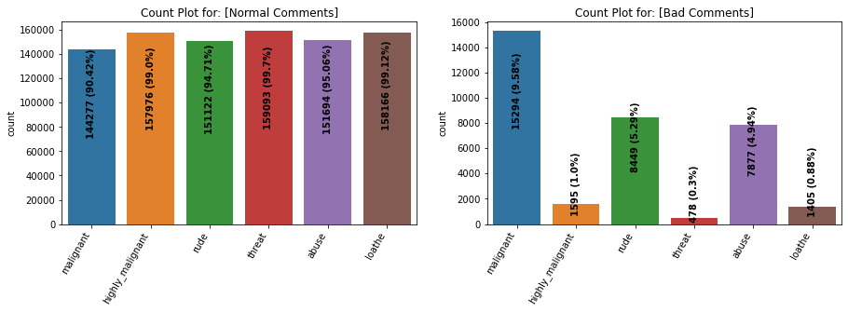
Exploratory Data analysis (eda) & visualization
Univariate Analysis
Univariate analysis is the simplest form of data analysis where the data being analyzed contains only one variable. In this project, distribution plot, count plot, box plot and bar plot has been used.
Count Plot:
Remarks:
Dataset consists of higher number of Normal Comments than Bad or Malignant Comments. *Therefore, it is clear that dataset is imbalanced and needs to be handle accordingly.
Most of the bad comments are of type malignant while least number of type threat is present in dataset.
Majority of bad comments are of type malignant, rude and abuse.

Slide 13
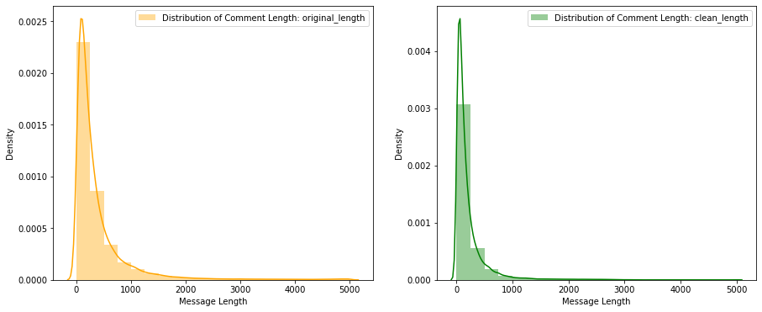
Exploratory Data analysis (eda) & visualization
Univariate Analysis: Distribution Plot
Remarks:
Before cleaning comment text, most of the comment's length lies between 0 to 1100 while after cleaning, it lies between 0 to 900.

Slide 14
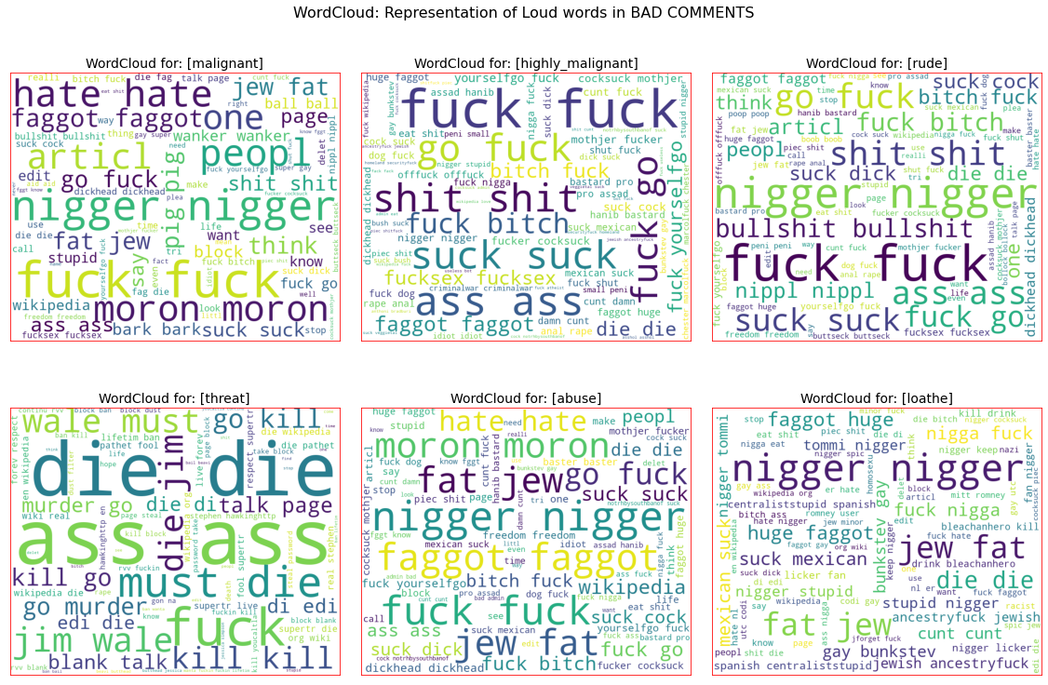
Exploratory Data analysis (eda) & visualization
Word Cloud : Display

Slide 15
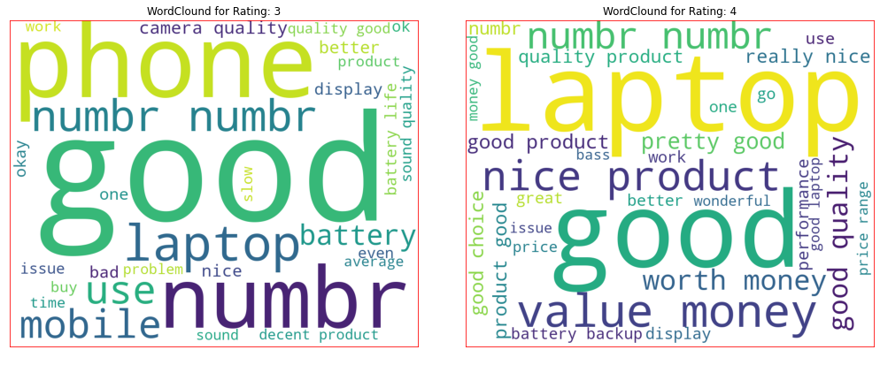
Exploratory Data analysis (eda) & visualization
Word Cloud : Display

Slide 16
Exploratory Data analysis (eda) & visualization
Word Cloud : Remarks
Remarks:
From wordcloud of malignant comments, it is clear that it mostly consists of words like fuck, nigger, moron, hate, suck ect.
From wordcloud of highly_malignant comments, it is clear that it mostly consists of words like ass, fuck, bitch, shit, die, suck, faggot ect.
From wordcloud of rude comments, it is clear that it mostly consists of words like nigger, ass, fuck, suck, bullshit, bitch etc.
From wordcloud of threat comments, it is clear that it mostly consists of words like die, must die, kill, murder etc.
From wordcloud of abuse comments, it is clear that it mostly consists of words like moron, nigger, fat, jew, bitch etc.
From wordcloud of loathe comments, it is clear that it mostly consists of words like nigga, stupid, nigger, die, gay cunt etc.

Slide 17
Exploratory Data analysis (eda) & visualization
Concluding Remarks
Starting with univariate analysis, with the help of count plot it was found that dataset is imbalanced with having higher number of records for normal comments than bad comments (including malignant, highly malignant, rude, threat, abuse and loathe). Also, with the help of distribution plot for comments length, it was found that after cleaning, most of comments length decreases from range 0-1100 to 0-900. Moving further with wordcloud, it was found that malignant comments consists of words like fuck, nigger, moron, hate, suck ect., highly_malignant comments consists of words like ass, fuck, bitch, shit, die, suck, faggot ect., rude comments consists of words like nigger, ass, fuck, suck, bullshit, bitch etc., threat comments consists of words like die, must die, kill, murder etc., abuse comments consists of words like moron, nigger, fat, jew, bitch etc. and loathe comments consists of words like nigga, stupid, nigger, die, gay cunt etc.

Slide 18
Model/s Development and Evaluation
Identification of possible problem-solving approaches (methods)
To solve this problem following steps are used:
Load Dataset using pandas
Remove null values
Drop column id
Convert comment text to lower case and replace '\n' with single space.
Keep only text data ie. a-z' and remove other data from comment text.
Remove stop words and punctuations
Apply Stemming using SnowballStemmer
Covert text to vectors using TfidfVectorizer
Separate Input and Output Variables.
Train & Test the Model by supplying Input and Output Variables.

Slide 19
Model/s Development and Evaluation
Testing of Identified Approaches (Algorithms)
Following are the list of algorithms used for training and testing:
GaussianNB
MultinomialNB

Slide 20
Model/s Development and Evaluation
Run and Evaluate selected models
A total of 2 algorithm has been used on this dataset for training testing purpose, these are GaussianNB and MultinomialNB. From the model performance comparison it is clear that MultinomialNB out-performs the other models with accuracy_score of 90.74% and hamming loss: 2.4%. Therefore, continuing with MultinomialNB as final model.

Slide 21
Conclusion
Key Findings and Conclusions of the Study
From the model comparison it is clear that MultinomialNB performs better with Accuracy Score: 90.74% and Hamming Loss: 2.4% than other models. Therefore, proceeding with MultinoimialNB.

Slide 22
Conclusion
Learning Outcomes of the Study in respect of Data Science
During the data analysis, comment_text feature contains text as well as numbers but I have only taken text and discarded the numbers. But these numbers can also be replaced with some other text which might impact the model performance either in positive or negative way. As of now, I am finishing this project with my current approach which gives the final accuracy score of 90.74% and hamming loss: 2.4% and this can be further improved by training with more specific data.

Slide 23
Conclusion
Limitations of this work and Scope for Future Work
Current model is limited to comments text data but this can further be improved for other sectors of foul language detection by training the model accordingly. The overall score can also be improved further by training the model with more specific data.

